Slide 1
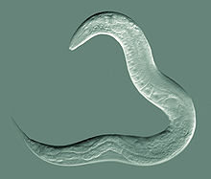
Genetics Analyses of Model Organisms
C. elegans (worm)
Heng-Chi Lee
Office: CLSC 853

Slide 2
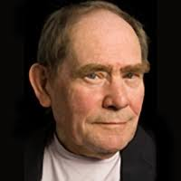
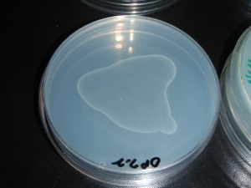
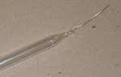
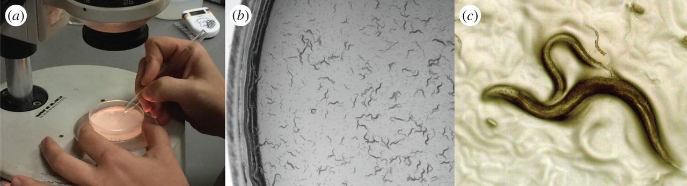
History of choosing C. elegans
Sydney Brenner, a bacteriophage geneticist, aimed to understand the genetic basis behind the animal nervous system, in particular how a nervous system is constructed. He settled on C. elegans as a model organism because of its simplicity. He published his first C. elegans paper “The genetics of C. elegans” in 1974 that describes isolating several hundred mutants”.
Sydney Brenner
Scott W. Emmons, 2015
Notes:
Won 5 Novel Laureates (and coming?)
Grow worms on agar plates seeded with bacteria, a platinum wire for picking the worm, a simple desktop dissecting microscope, and you are pretty much in business
A high school student can learn most of the trick in a week!

Slide 3
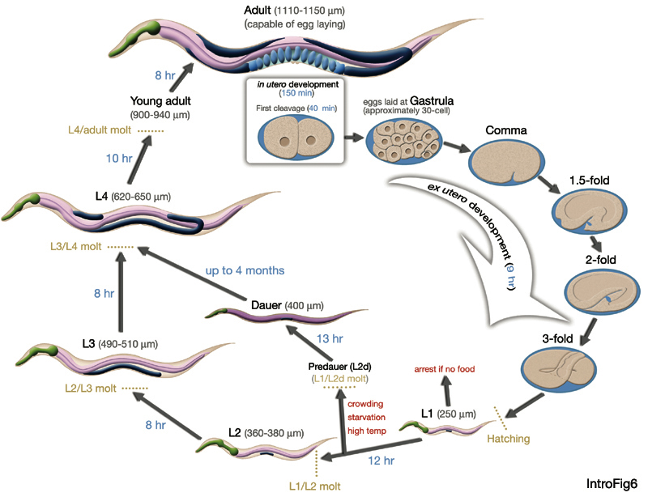
Life Cycle
1.2 mm long
Notes:
Adult is about 1 mm long, which you can just able to see it with your naked eye. A fertilized egg is dividing inside the utero till 30 cell stage before being laid. Amazingly, It then develops inside the egg shell, without eating, into a worm-like creature and eventually hatched, which entered the Larva1 or L1 stage….Importnatly, there are few unique feature about their life cycle, if the food souce is restricted, L1 can go to arrest and suvive without food for around 10 days. Between L1 or L2 stage, if the worm encounter high tem...they can go into Dauer stage, where they can survive to up to 4 month!!

Slide 4
Why C. elegans
A small animal (1.2mmlong) with a short life cycle (3 days/generation)
Hermaphroditic (can self fertilize!!) while is also crossable (easy for genetic screen and strain maintenance)
Transparent (dream organism for cell biologist!)
Affordable and easy to grow (bacteria as food source in the lab and can be grown in large quantity on agar plates or liquid, 1 hermaphrodite animal gives > 250 progenies)
Invariant cell lineage (959 somatic cells, ideal for studying developmental control)
All 8000 neuron synapses between 302 neuron are mapped!!
Small genome (only 20X of E. coli and 3% of human), genome sequence available
Great toolkits for genetics/RNAi/gene editing
Strains can be frozen
Notes:
Neuronal connections are completely mapped by electron microscope, allowing dissecting
The specific behavior with a particular neuronal circuit.

Slide 5
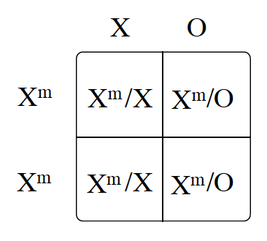
C. elegans is hermaphroditic and diploid
XX: hermaphrodites, XO: males (5 pairs of somatic chromosomes)
Hermaphrodite germline initially produces sperm (L4 stage), and then switches to produce oocytes in adult and start self fertilization
Males are produced by hermaprhodites at low frequency through meiotic non-disjunction of X chromosome (~0.2%)
When hermaphrodites mate with males, male’s sperm are preferentially used for fertilization.
Q: What is the frequency of male progenies from hermaphrodite crossed with male?

Slide 6
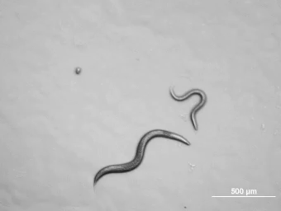
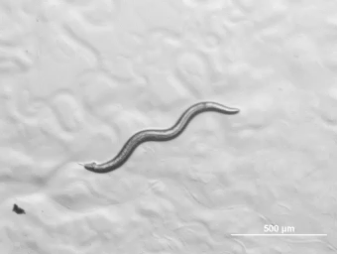
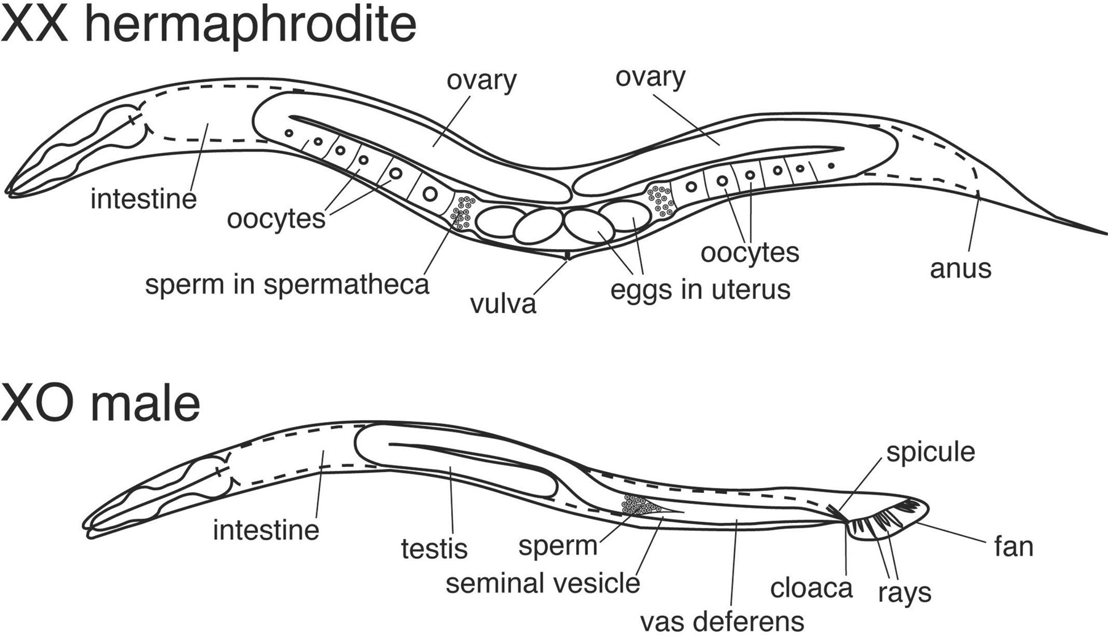
Hermaphrodite vs. male
99.8%
0.2%

Slide 7
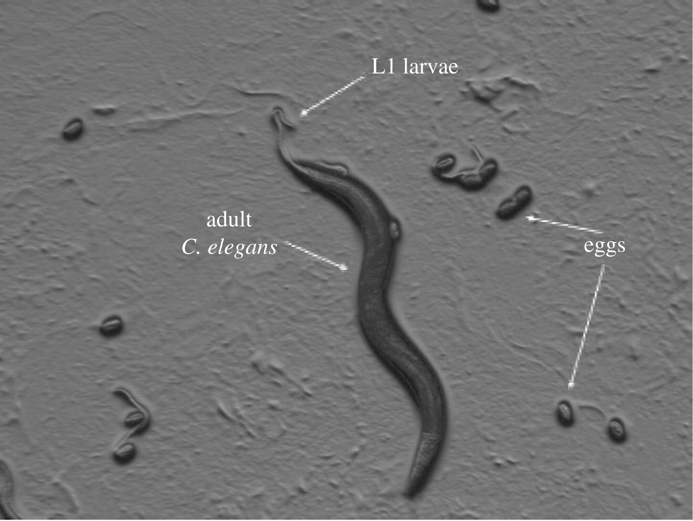
Synchronization/freezing/expansion
mix-staged worms
Bleaching (5 min)
embryos
rotating in buffers
w/o food (>overnight)
L1 arrest (synchronized)
Frozen
-80 or
liquid nitrogen
food
(50hr)
synchronized adults
Notes:
How you synchronize/freezing/freezing c. elegans

Slide 8
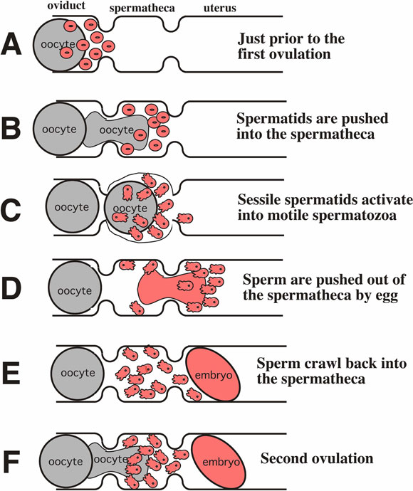
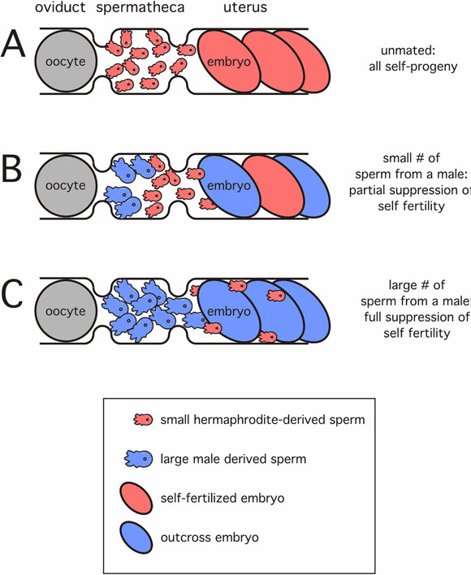

Worm mating

Slide 9
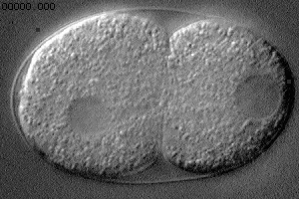
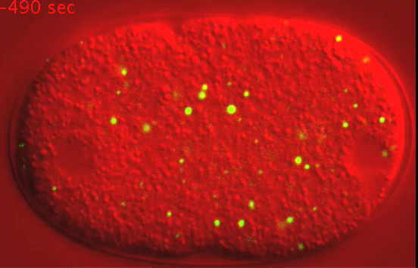
Transparent animals allow live imaging of various developmental process
^{Ideal to examine cell division}
^{/embryogenesis}
P granule (germ cell enriched)
(Brangwynne C. 2009)
Differential Interference Contract (DIC), or Nomarski

Slide 10
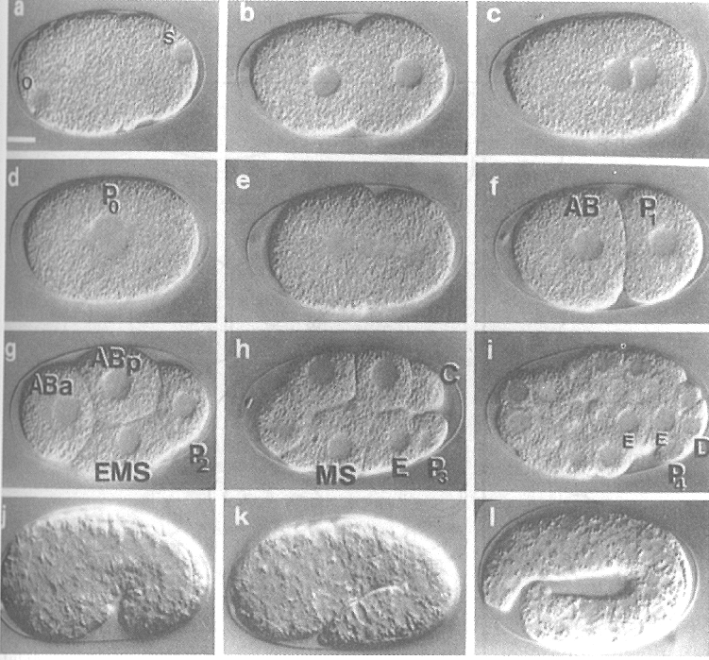
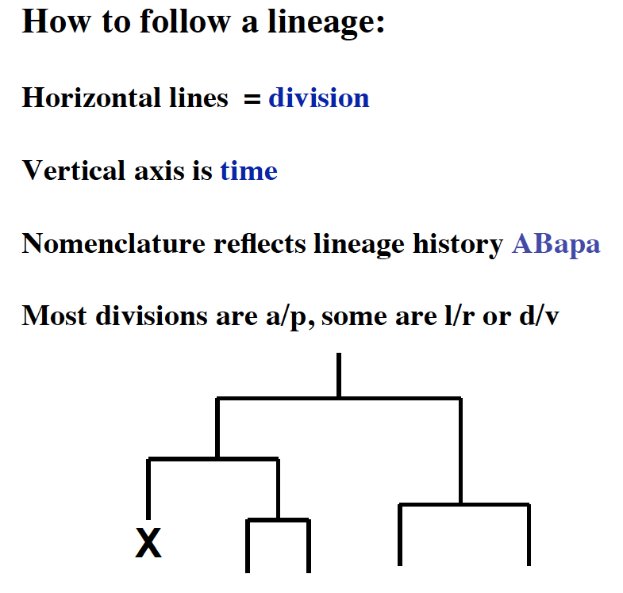
Constructing the cell lineage simply by watching!
Q: What is ABalaa cell?
Notes:
ABalaa is the Anterior daughter of the anterior daughter of the left daughter of the anterior adughter of AB

Slide 11
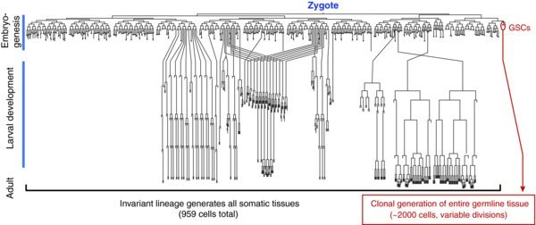
Invariant cell lineage of C. elegans
Each C. elegans hermaphrodite has the same number of somatic cells (959 cells),
131 cells die through programed cell death
*Mutants that change the cell fates can be discovered (discovery of miRNA).
Notes:
Remarkably, the C. elegans have invariant cell lineage

Slide 12
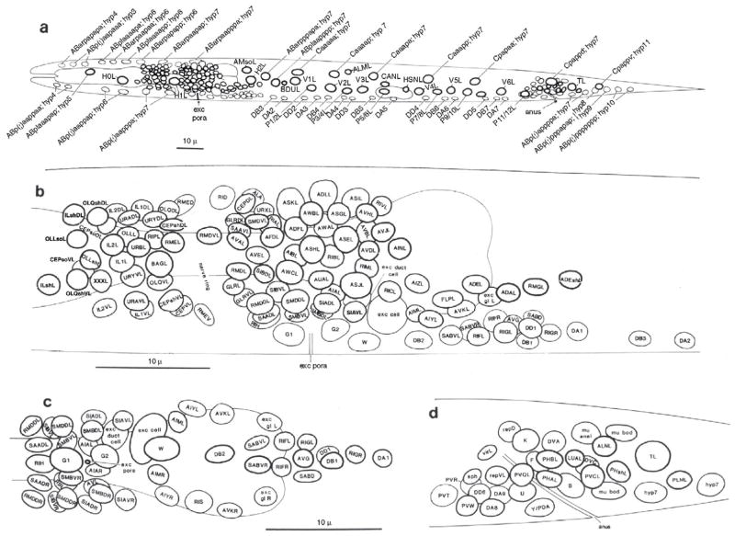
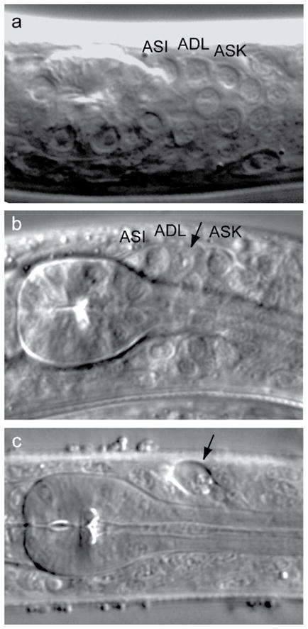
Laser ablation to investigate the function of a cell
Sulston et al., 1983
Christopher Fang-Yen et al. Methods Cell Biol. 2012

Slide 13
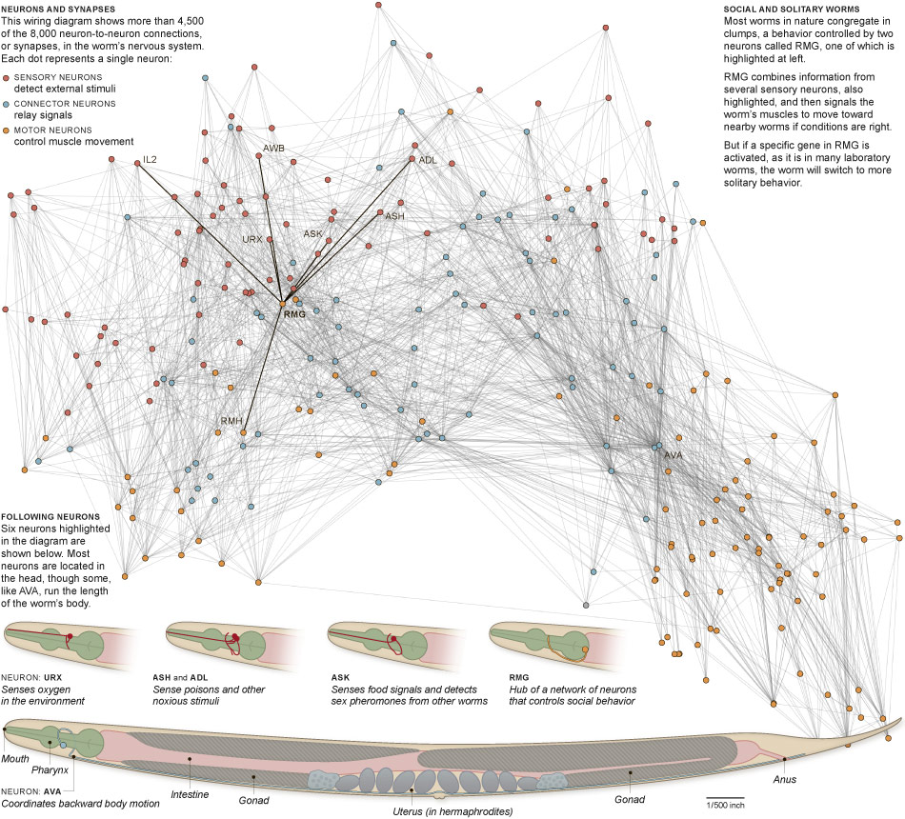
https://theconnectome.wordpress.com/2011/06/21/mind-mapping/
Notes:
A pair of RMG neurons signals the worm to move to nearby worms, but some of the RMG genes (npr-1) are activated, frequently happen in the laboratory worms, will keep the worm in more solitary mode.

Slide 14
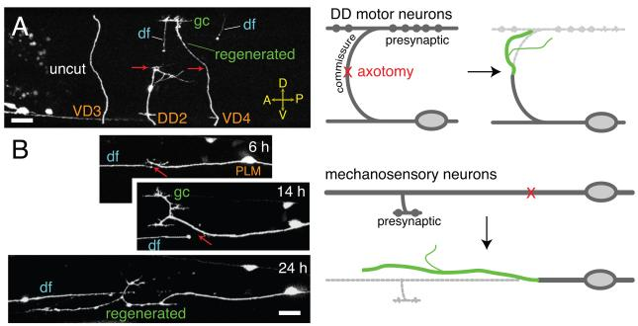
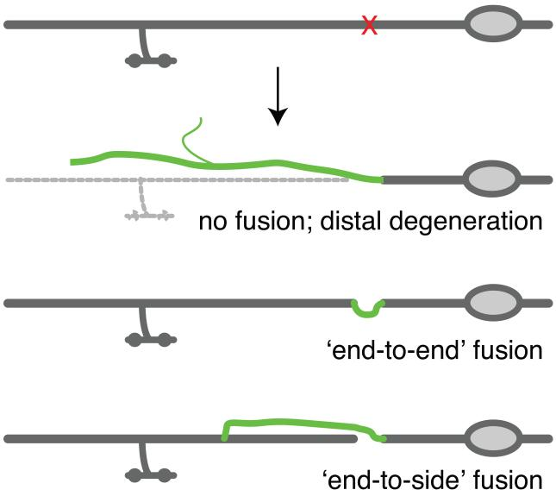
C. elegans for study of neuron regeneration
Lizhen Chen et. al. Trends in Cell Biology
2011

Slide 15
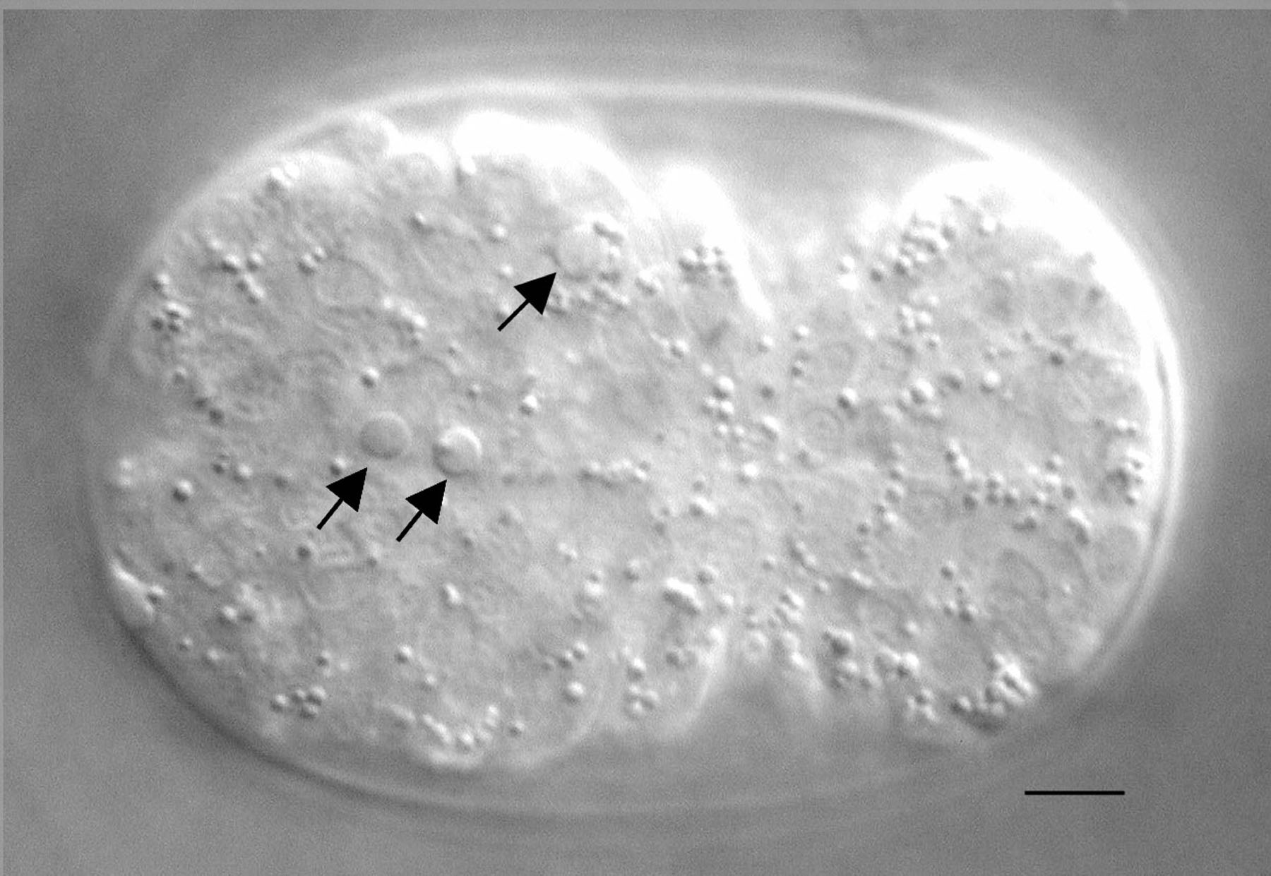
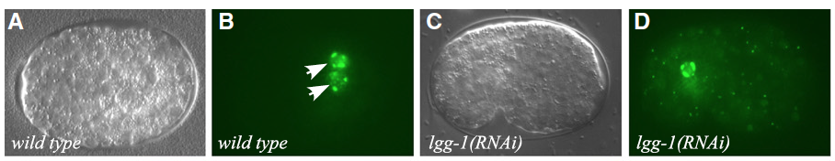
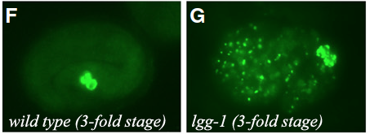
Key discoveries made in C. elegans
Apoptosis
(programed cell death)
Autophagy
(degrades intra-
cellular components
& recycling)
A screen that identifies mutants failing to degrade
p granule in embryos discovered several genes
involved in autophagy (Zhang et al. 2009)
Small non-coding RNAs (Discovery of RNA interference & miRNA)
Aging
Neuronal cell fate/connection/function

Slide 16
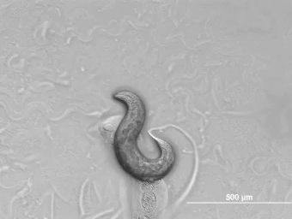
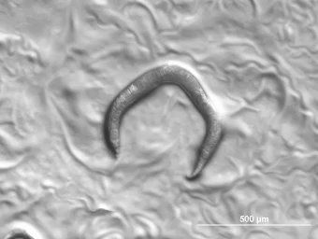
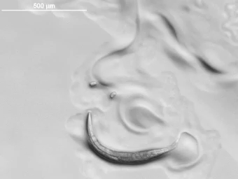
Genes and nomenclature in C. elegans
Wild type
dpy-10 (dumpy)
http://wormclassroom.org
rol-6 (rolling)
unc-22 (uncoordinated)

Slide 17
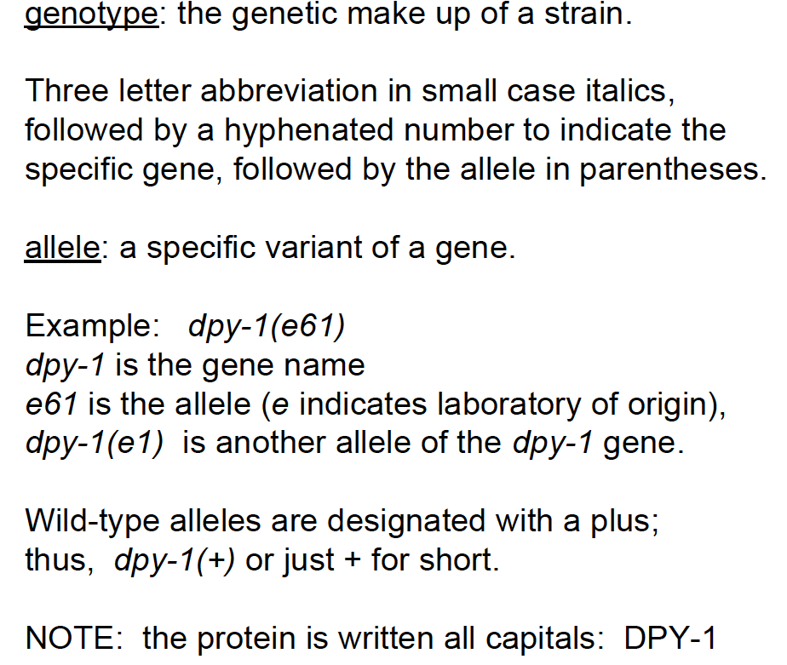
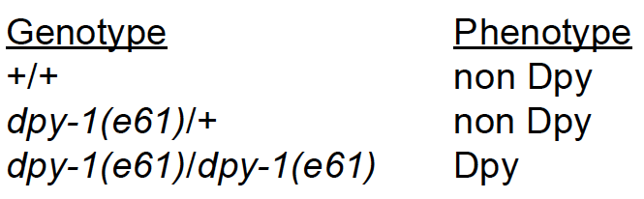
Q: Can you tell the genotypes of a mutant from single picked hermaphrodites?

Slide 18
Genetic strategies frequently used in C. elegans
Forward genetic screen to identify mutants with desired phenotype (simple/suppressor/enhancer screens)
Complementation
Mapping (SNP/deep sequencing)
Genome editing (CRISPR) to create desired mutations
Transgenic animals to express tagged or mutated genes
(MosSCI: transposase mediated single copy
insertion)
RNAi

Slide 19
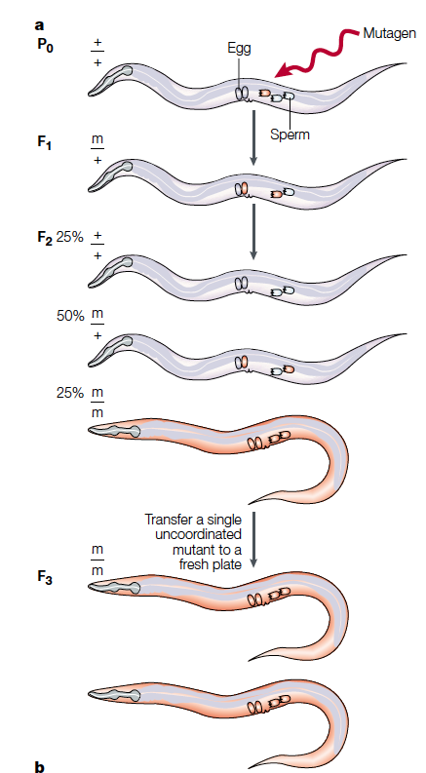
A simple F2 screen
Q: How do you recover a mutant that is lethal?
Notes:
Once the mutation occur in sperm or oocyte, the F1 is going to be heterozygous for the mutation, and self progeny of this specific F1 will produce F2 progeny that are homozygous for the mutation.
Therefore, in general, we mutate the C. elegans in P0 and screen the phenotype at F2 generation.

Slide 20
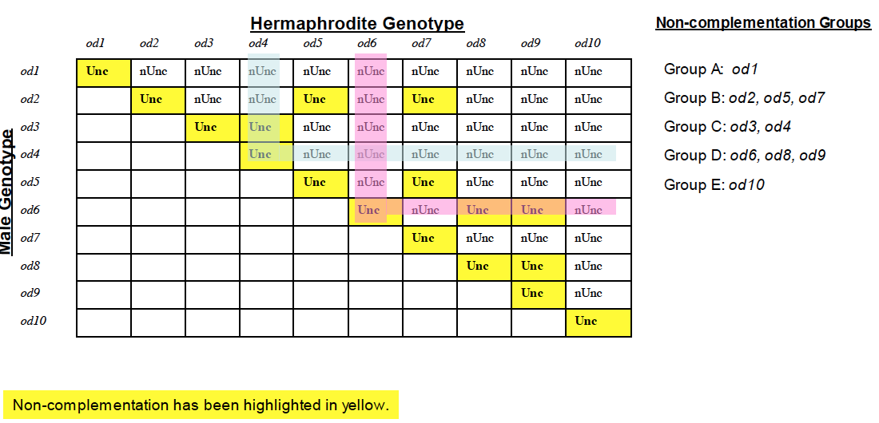
Complementation test
*Most of times the mutants that are non-complement contain mutations in the same gene
Q: How can we avoid isolating the same mutant over and over again?

Slide 21
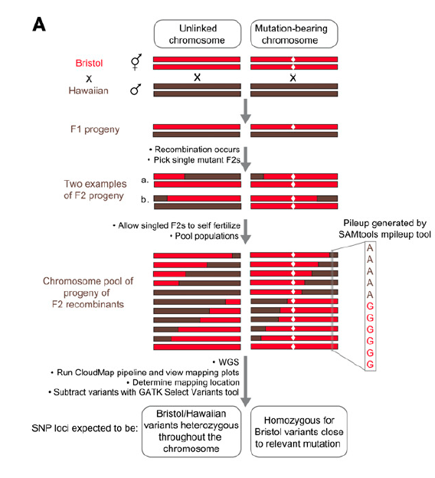
Mapping by crossing Bristol mutants (lab strain) to Hawaiian (a wild isolate) with hundreds of SNPs
Pooling the genomic DNAs of multiple F2 worms with mutant phenotype
constructing DNA library for deep sequencing
Q: What is the frequency of unlinked SNPs ( %) & closely linked SNPs ( %) in the DNA pools?
Minevich et al. 2012

Slide 22
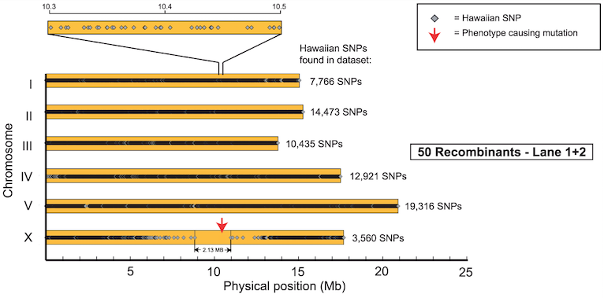
When crossing Bristol mutant to Hawaiian strain, the genomic region that are depleted of Hawaiian-specific SNPs likely resides the causal mutation.
Doitsidou M et. Al. (2010)

Slide 23
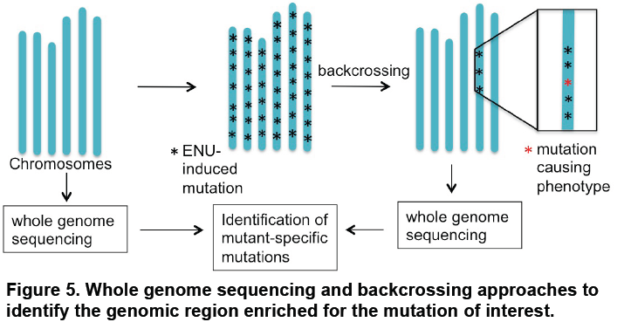
Mapping with backcrossing to the original strain & deep sequencing

Slide 24
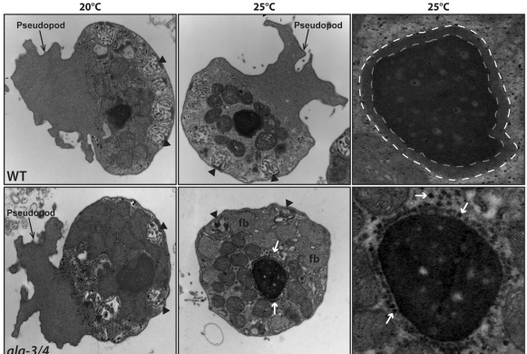
A example of modern genetic mapping in C. elegans
Male animals of alg-3;alg-4 (Argonaute) double mutant are infertile at higher temperature with specific sperm defects
perinuclear
halo
WT
No halo,
but with
Abnormal
tubular
structure
alg-3;
alg-4
Coline C, et al. 2013

Slide 25
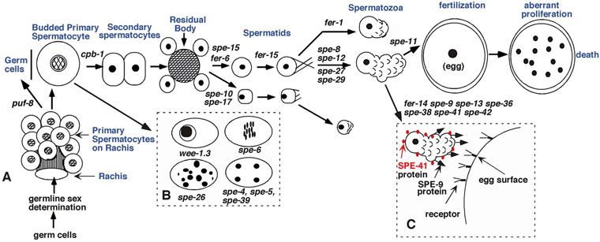
Spermatogenesis in C. elegans
Wormbook (spermatogenesis)

Slide 26
fer-2 sperm nuclei also exhibit the abnormal tubular structure and the loss of perinuclear halo
fer-2
fer-6
Samuel ward, et al. 1981
fer-2 has been mapped to specific DNA loci
(III:7.24 +/- 0.124 cM) but is not yet cloned
Notes:
, Previous screen has identified temperature-sensitive male sterile mutant, including fer-3,fer-15,fer-2,fer-4 and fer-6.
Intresting In the picture,FER-2,3,4 also have perinuclear tubules, at the same time, the RNA halo disappear. Arrows show large tubules around the nucleus (N) in place of the perinuclear halo.
In the picture,FER-2,3,4
While the fer-6 had the RNA hale
Tubules around the nucleus in place of the perinuclear halo in some fers mutant

Slide 28
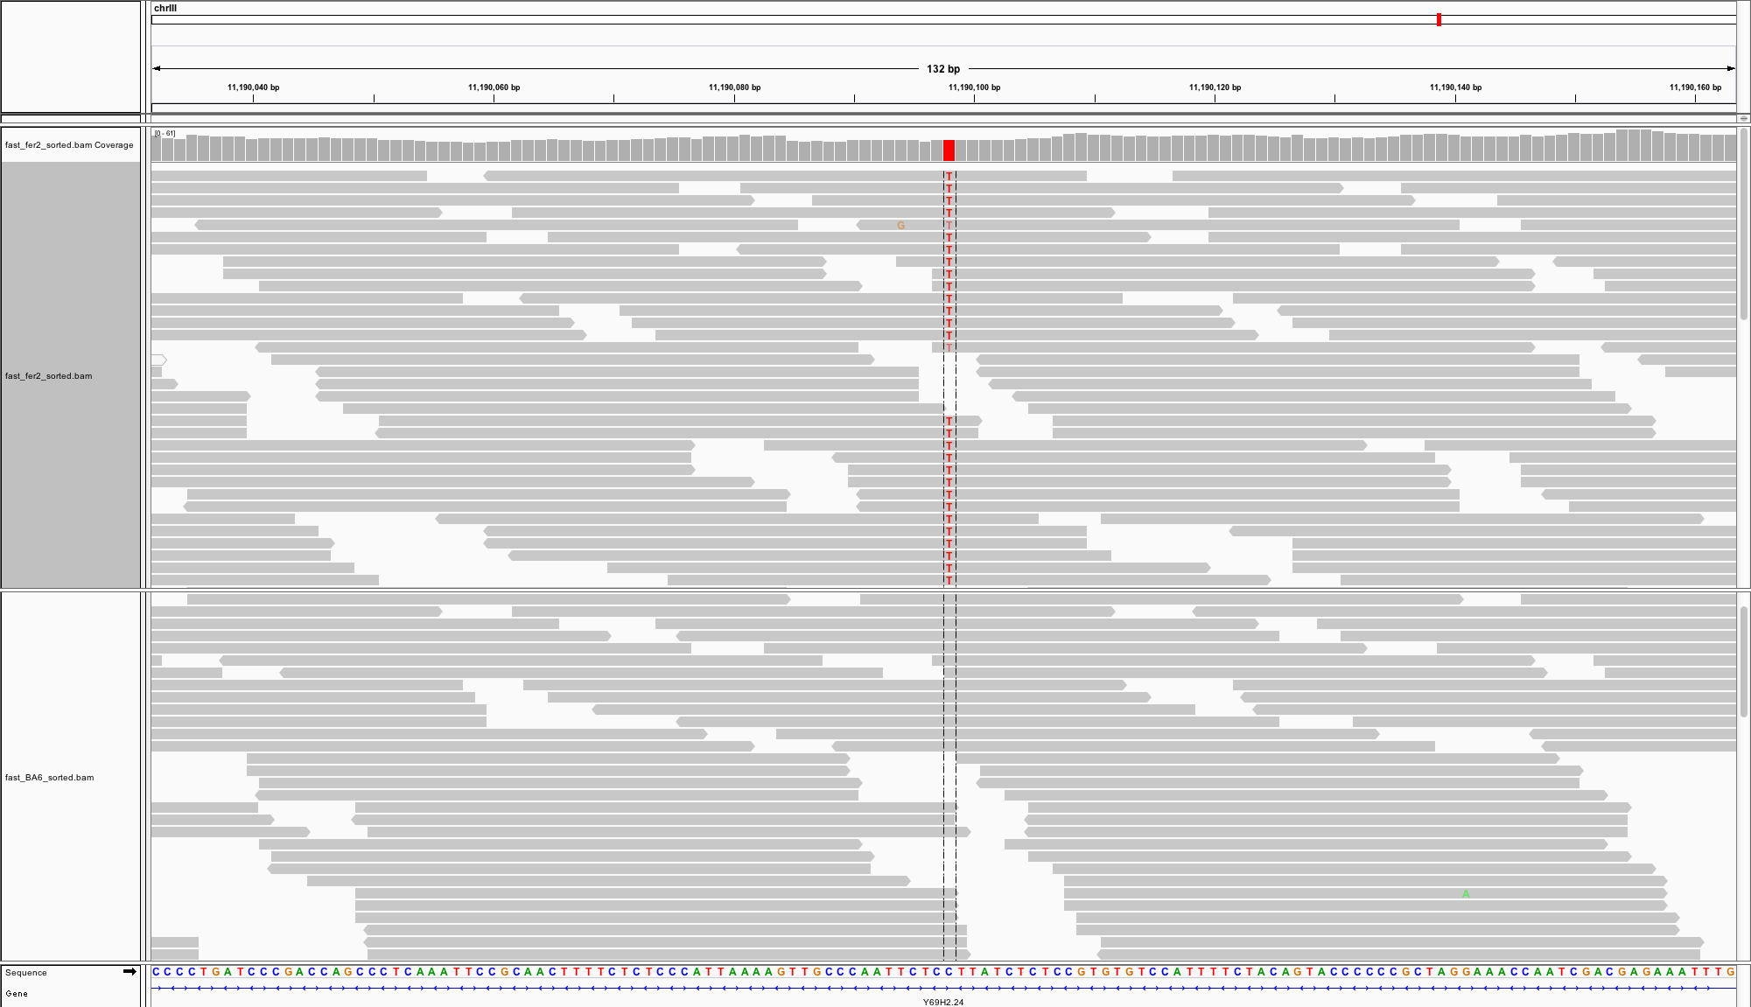
Genome Sequencing of fer-2 and fer-6 mutants
fer-2
fer-6
fer-2 genome contains a mutation that lead to non-sense mutation (an early stop codon, TGG to TAG) in mib-1 gene
Q: How do you know this mutation is the causal mutation?

Slide 29
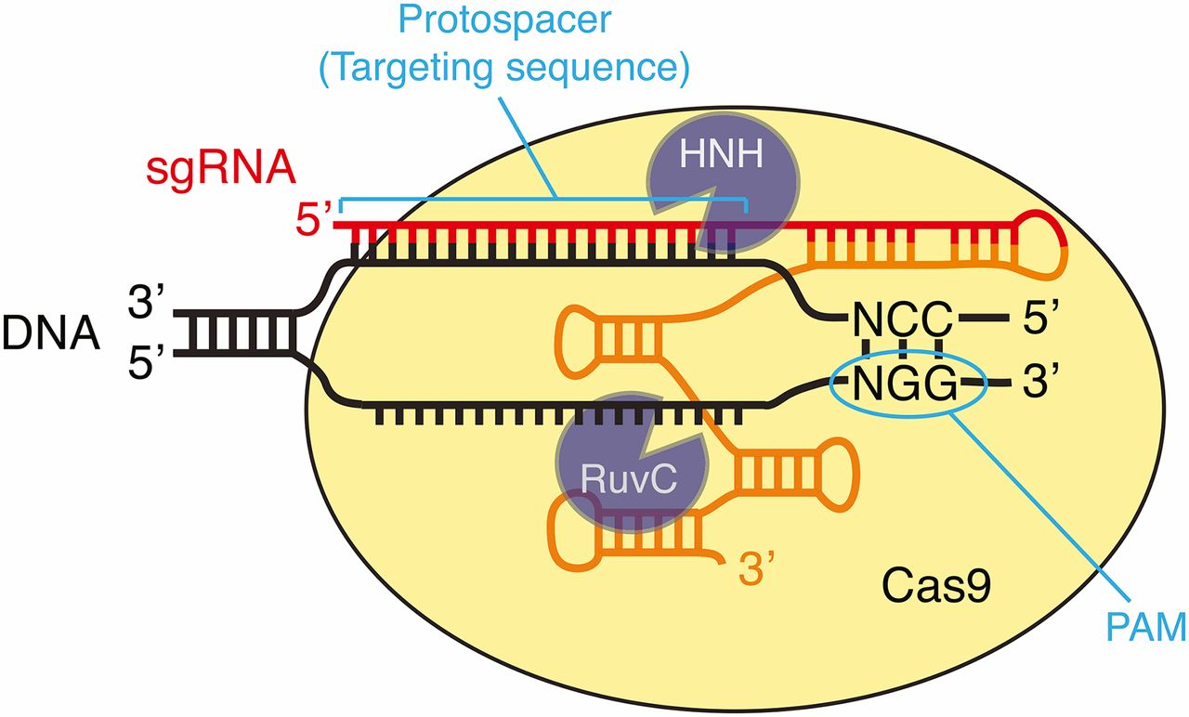

DNA recognition by the Cas9–sgRNA complex.
Daniel J. Dickinson, and Bob Goldstein Genetics 2016;202:885-901
Copyright © 2016 by the Genetics Society of America
Notes:
DNA recognition by the Cas9–sgRNA complex. Cas9 identifies its substrates by first binding to the PAM (NGG motif) and subsequently by base pairing of the sgRNA cofactor to the substrate DNA. HNH and RuvC are the two Cas9 nuclease domains that cleave the sgRNA-complementary and noncomplementary strand of the target DNA, respectively. Red and orange in the sgRNA indicate the portions derived from the bacterial crRNA and tracrRNA, respectively.

Slide 30
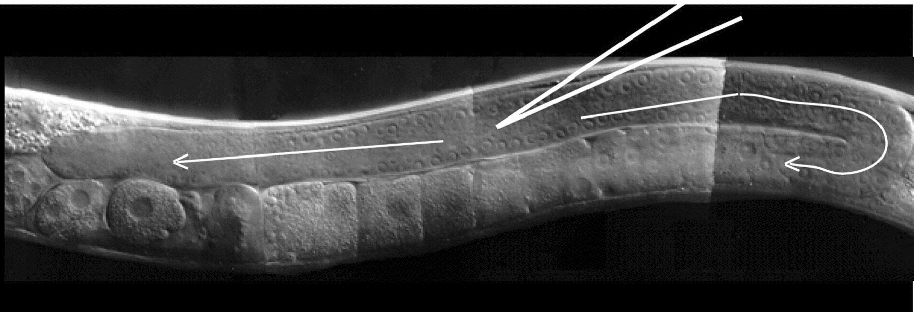
Microinjection/ extrachromosomal array/ co-CRISPR
Injection of Plasmid DNA
recombination
rol-6
(dm)
mCherry
Cas9/sgRNAs (unc-22)
Formation of extrachromosomal array
(multi-copies of all/most plasmids)
Pick F1 animals with markers indicating successful injection,
or F2 animals with co-CRISPR marker (ex. unc-22)
Genotyping F1 or F2 candidates for desired gene-editing events
Genes in extrachromosoma arrayl are expressed in somatic tissue and are temporally expressed in
Germ cells. Arrays can replicate and can be inherited (typically 20% to 50% to the next generation)

Slide 31
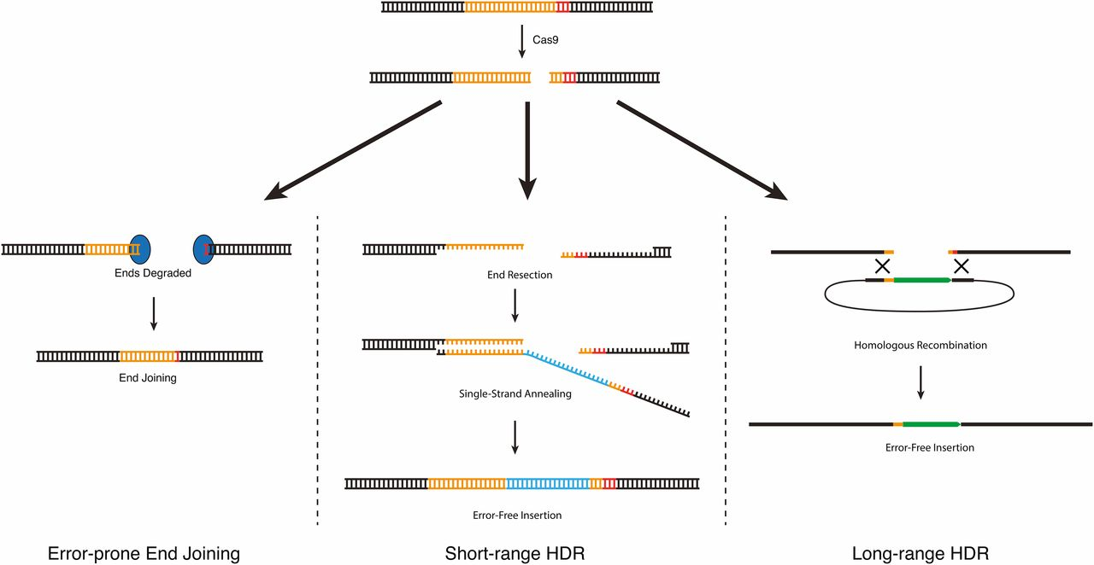
CRISPR-based genome engineering
Polymerase theta-dependent EJ
To create null mutants
To create specific point mutation/ knock-in
To create knock-in
Daniel J. Dickinson, and Bob Goldstein Genetics 2016;202:885-901
Notes:
DNA repair approaches for CRISPR-based genome engineering. DNA double-strand breaks introduced by Cas9 can be repaired via three different mechanisms. End joining produces random insertion/deletion mutations. HDR produces error-free edits using an exogenous DNA molecule as a repair template. Although the mechanisms of HDR in C. elegans are not known, efficiency data suggest the existence of two different HDR pathways (see text). Short-range HDR is hypothesized to occur via a synthesis-dependent strand-annealing mechanism and can accommodate insertions of up to 1–2 kb, with the highest efficiency within 10 bp of the cut site. Long-range HDR is hypothesized to occur via a double-crossover mechanism and can accommodate insertions of at least 12 kb, at distances up to at least 1 kb from the cut site.

Slide 32
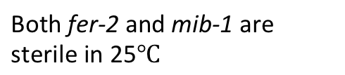
Does mib-1 complement fer-2 ?
Both fer-2 and mib-1 are sterile in 25
Number of progeny 25 $℃$
Complementation test:
cross fer-2 to mib-1
Wild type mib-1 N2 male x mib-1 fer-2 fer-2 male ;mib-1
Notes:
To test if mib-1 mutation cause the fer phenotype, first I put mib-1 in 25,mib-1 is sterile,mib-1 phemotype is the same to fer-2
Indeed, the mib-1 mutated animals shows male sterility at 25 degree, similar to fer-2
To test indeed fer-2 is mib-1, I performed a complementation test and examine the F1 cross progeny of fer-2 and mib-1 and indeed these F1 also are sterile at 25 degree. Togeter, I conlude mib-1 is fer-2

Slide 33
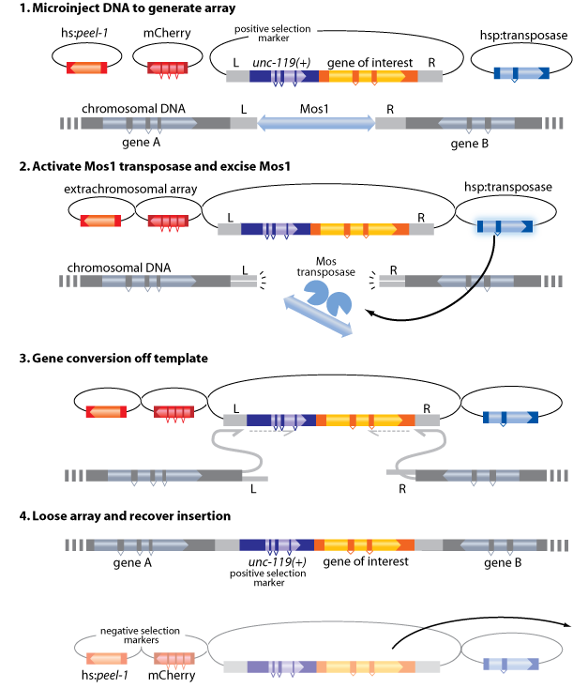
Creating transgenic animals by MosI transpon-mediated single copy insertion
Injected plasmid cocktails to
unc-119 animals (unc)
Pick non-unc,
mCherry+ F1s
Transposase expression leads
to excision of Mos1 transposon
HR-mediated insertion of the transgene
Pick non-unc,
mCherry negative worms
Genotyping to confirm insertion
GFP::MIB-1 transgene inserted on
Chrosome II rescues fer-2
fertility defects!!

Slide 34
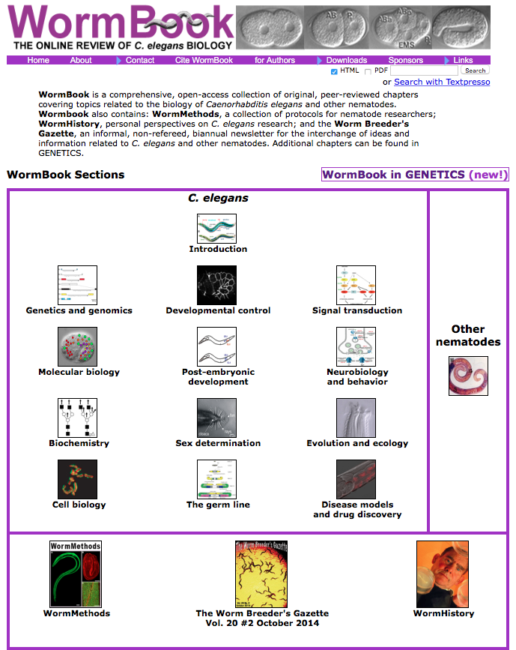
Useful websites for C. elegans Research
Wormbook
Wormbase.org
(gene expression profile,
RNAi phenotype/ sequences/
literature…)
CGC
(C. elegans Genetic Stock Center)

